Slide 1
Machine learning V Artificial Neural Networks

Slide 2
On the Shoulder of Giants
Much of the material in this slide set is based upon:
- ”Automated Learning techniques in Power Systems”
by L. Wehenkel, Université Liege
- ”Machine Learning” course by Andrew Ng, Associate Professor, Stanford University

Slide 3
Contents
Feedforward Artificial Neural Networks
Back propagation in Artificial Neural Networks

Slide 4
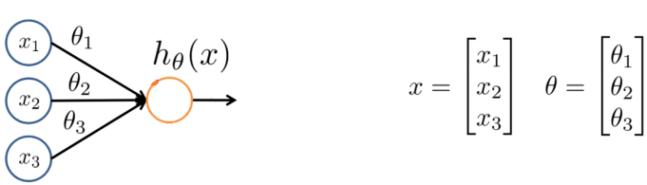
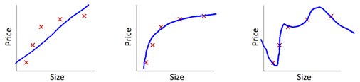
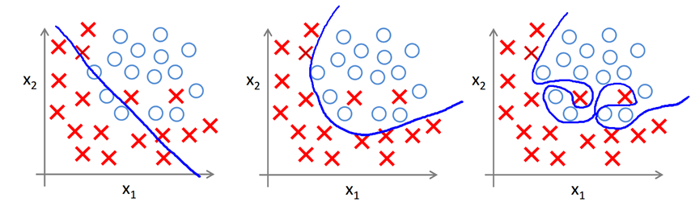
Regression VS classification
Regression (linear and polynomial): for prediction
Classification:
- Coping with over/under fitting
Source: ”Machine learning ” course, Andrew Ng

Slide 5
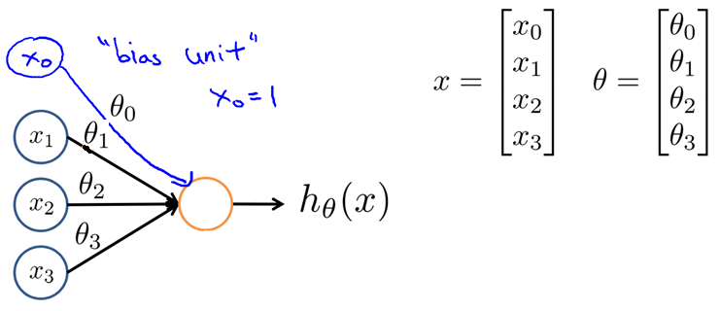
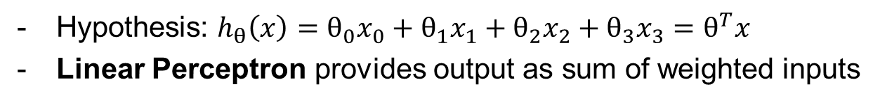
Linear regression: bias unit and normalization
Hypothesis: $h_{θ}\left(x\right)=θ_{0}x_{0}+θ_{1}x_{1}+θ_{2}x_{2}+θ_{3}x_{3}=θ^{T}x$
Linear Perceptron provides output as sum of weighted inputs
Source: ”Machine learning ” course, Andrew Ng

Slide 6
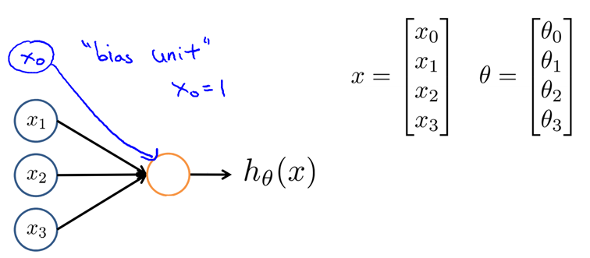
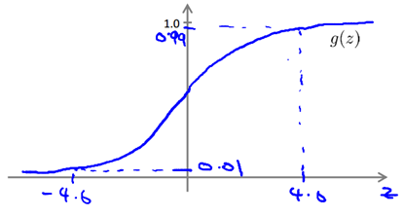
Classification (logistic regression)
Hypothesis: $h_{θ}\left(x\right)=g\left(\underset{z}{\underbrace{θ^{T}x }}\right), g\left(z\right)=\frac{1}{1+e^{−z}}$ (Sigmoidal function)
Non-linear perceptron normally uses a threhold function for the output, to limit the extreme values.
Source: ”Machine learning ” course, Andrew Ng

Slide 7
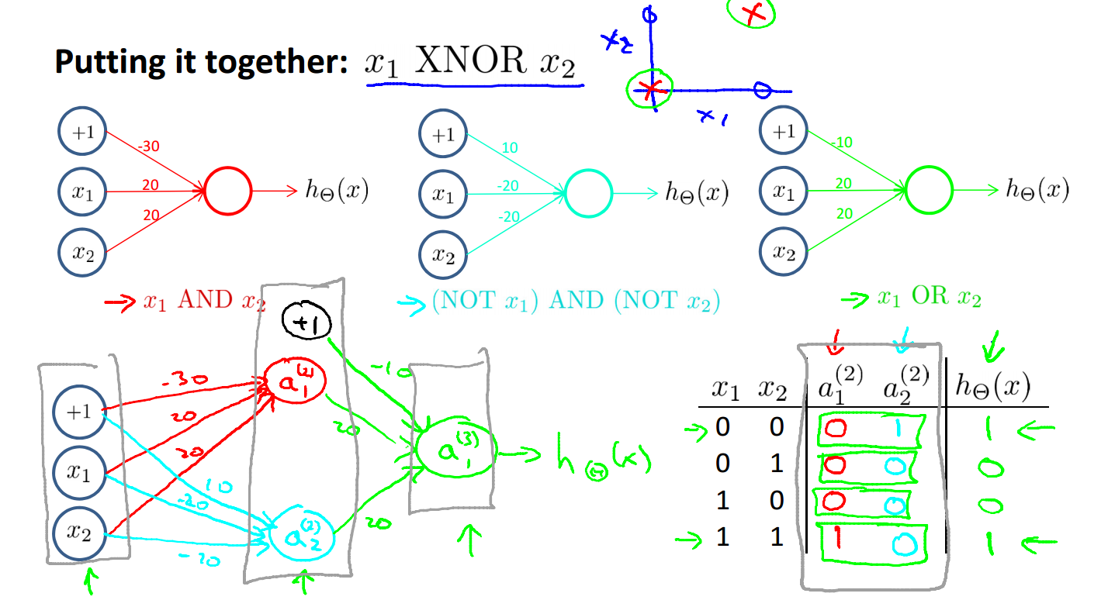
Example (multi-layer perceptron): XNOR function
Hypothesis: $h_{θ}\left(x\right)=g\left(\underset{z}{\underbrace{θ^{T}x }}\right), g\left(z\right)=\frac{1}{1+e^{−z}}$ (Sigmoidal function)
Source: ”Machine learning ” course, Andrew Ng

Slide 8
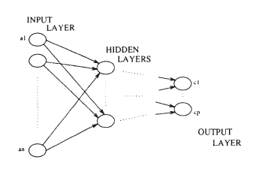
Multi Layer Perceptrons (MLP)
A network of interconnected Perceptrons in several layers
First layer recives input, forwards to second layer etc.
Normally one hidden layer is sufficient to create good mappings
Source: Automatic Learning techniques in Power Systems, L. Wehenkel

Slide 9
Contents
Feedforward Artificial Neural Networks
Back propagation in Artificial Neural Networks

Slide 10
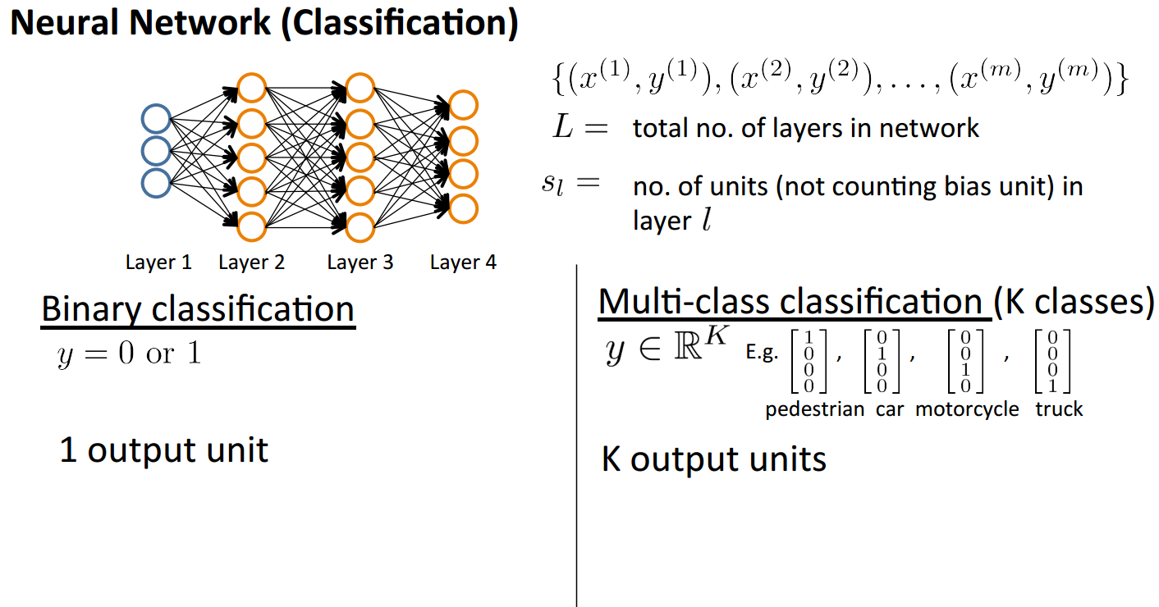
How to tune the weights? (Backpropagation algorithm)

Slide 11
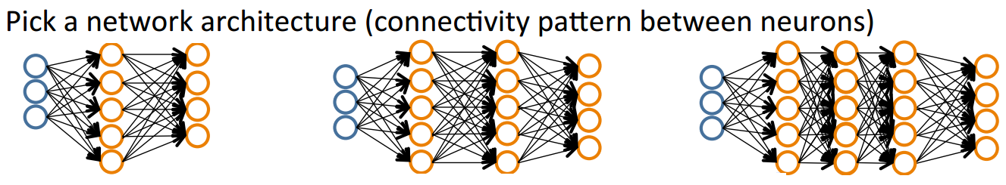
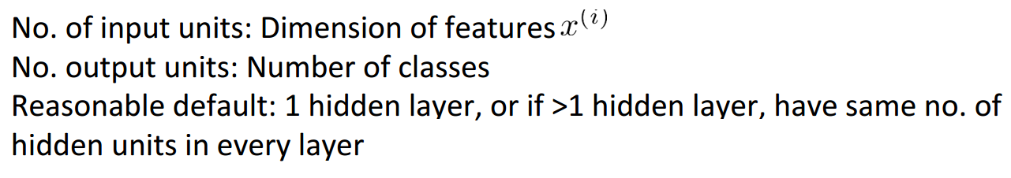
How to tune the weights? (Backpropagation algorithm)

Slide 12
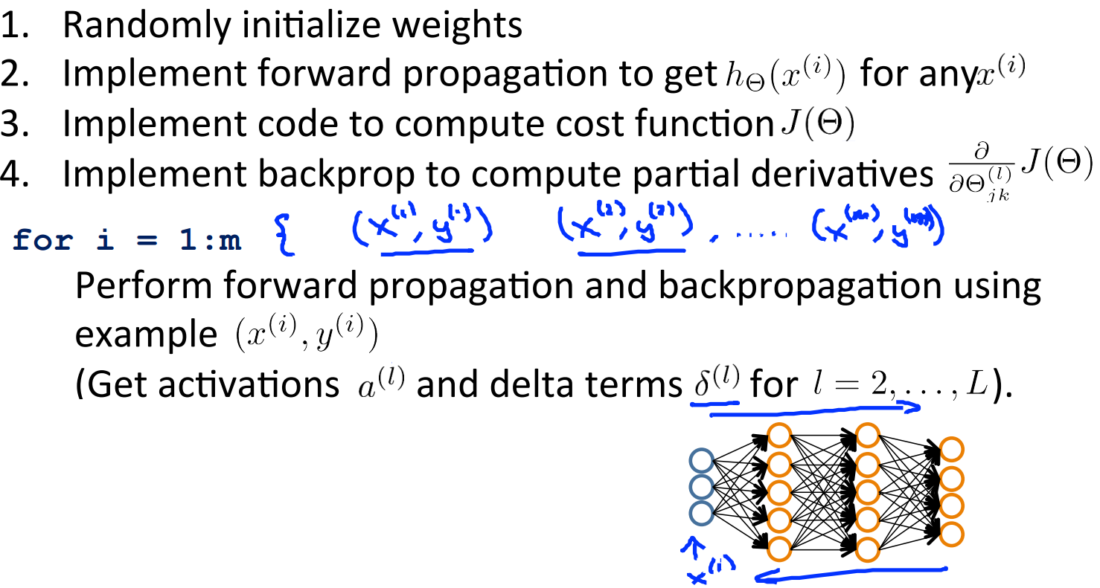
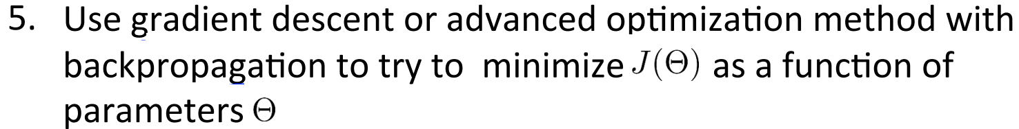
How to tune the weights? (Learning)

Slide 13
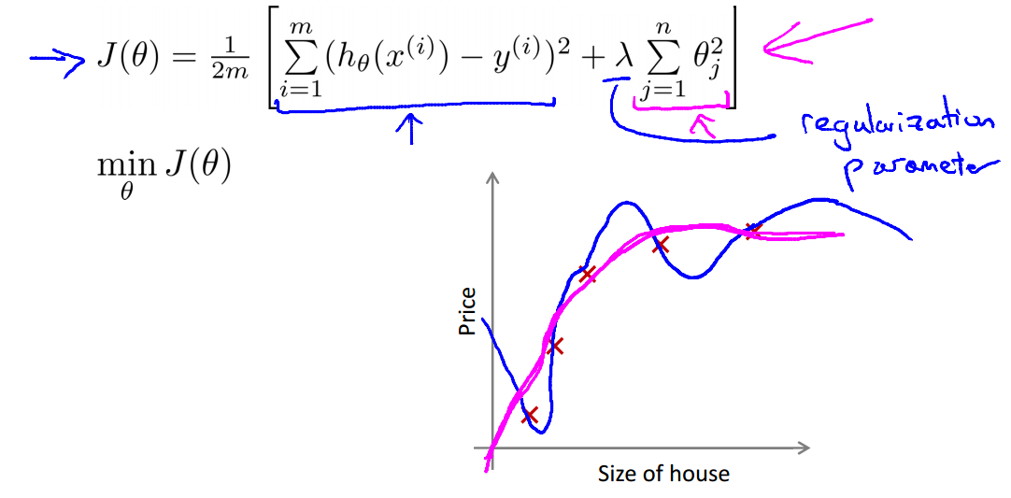
Cost function and Regularization
1) Cost function for Linear regression

Slide 14
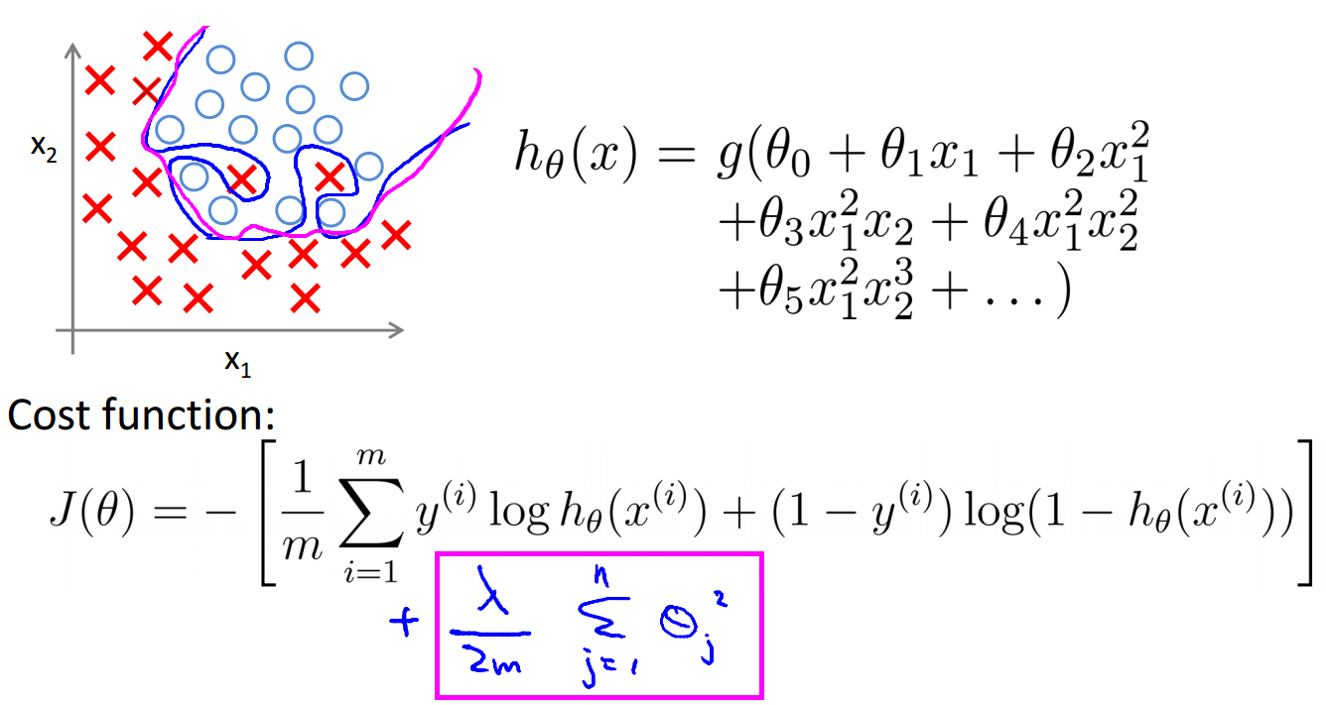
Cost function and Regularization
2) Cost function for classification (Logistic regression)

Slide 15
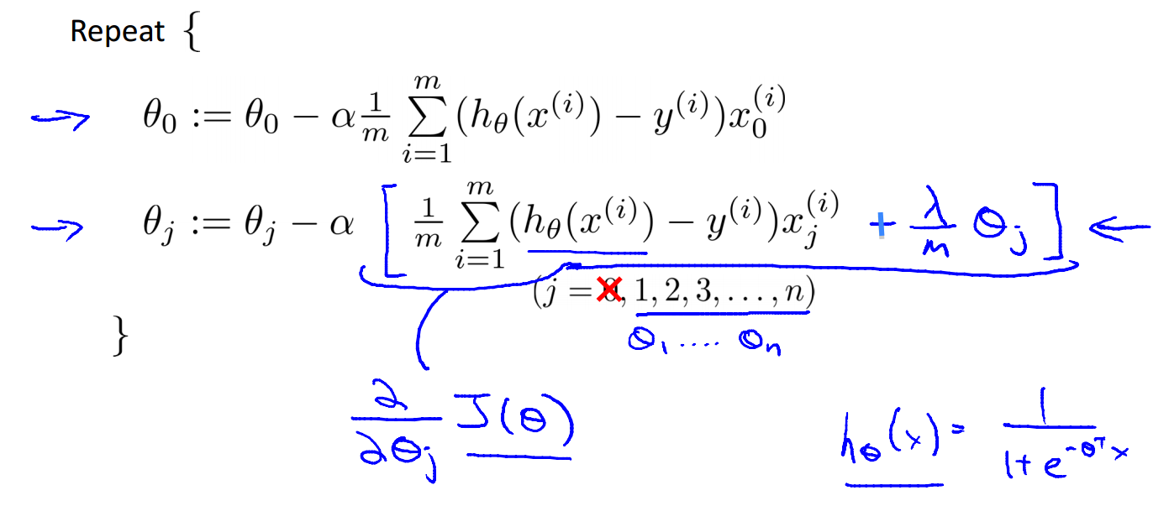
Gradient decent
Gradient decent for classification (Logistic regression), for the output layer

Slide 16
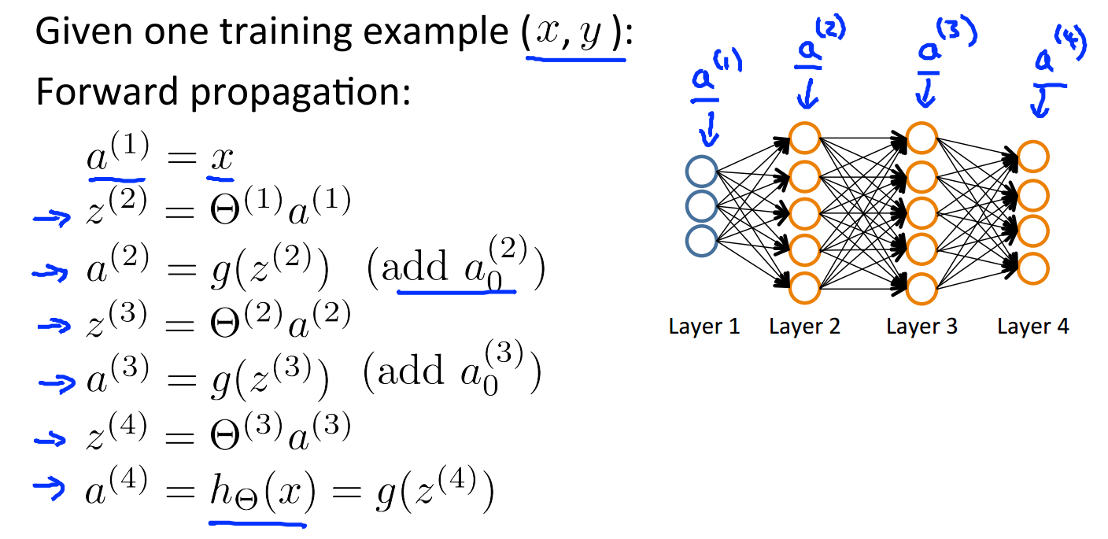
Gradient computation

Slide 17
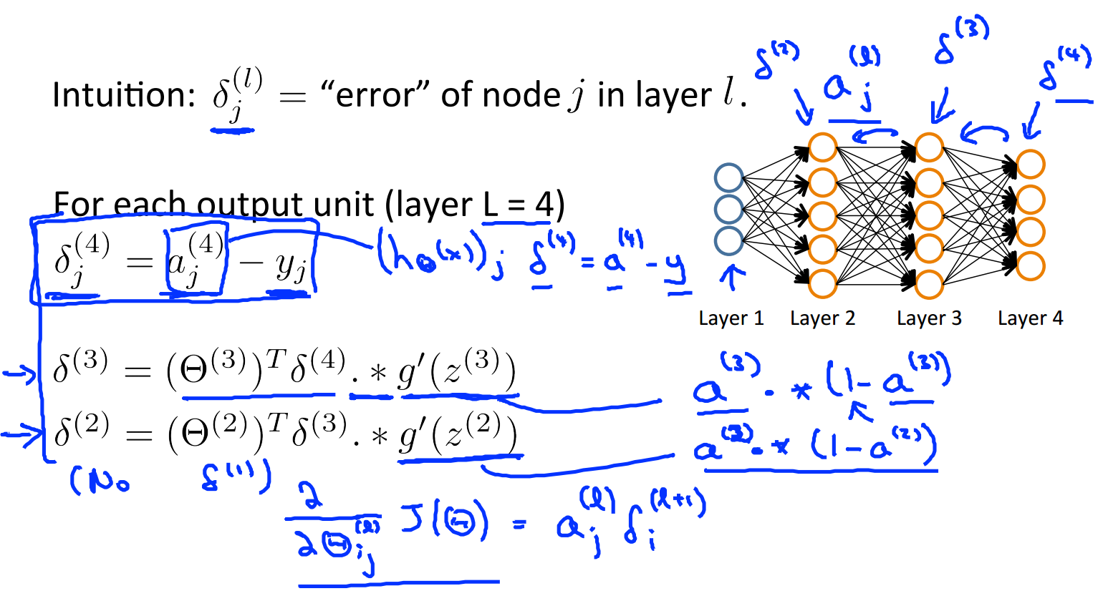
Gradient computation: Backpropagation algorithm

Slide 18
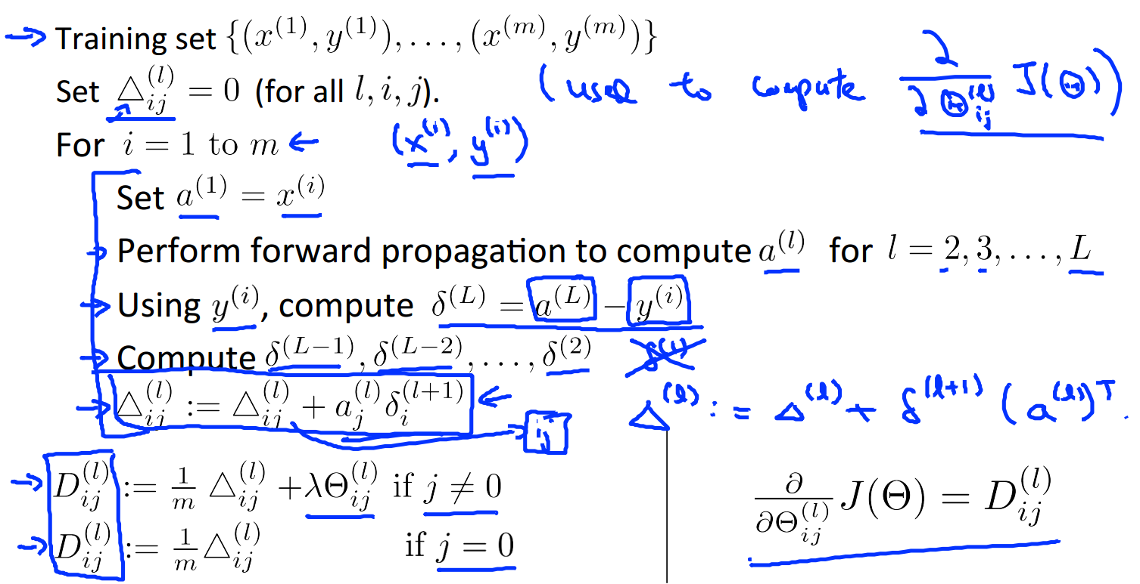
Gradient computation: Backpropagation algorithm

Slide 19
How to tune the weights? (Learning)

Slide 20
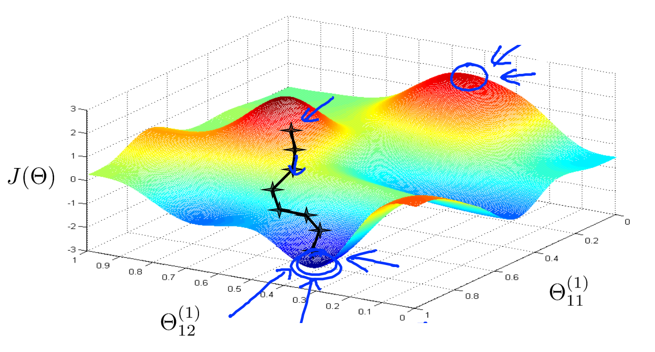
Try different initial random weights
If cost function is non-convex, trying different initial random weights can help to find the global minimum (e.g., by applying optimization techniques like PSO to find the best weights).

Slide 21
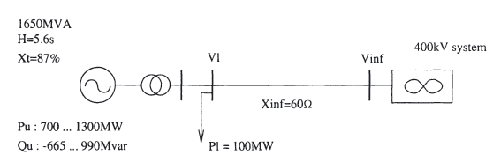
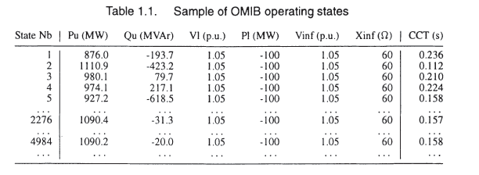
Example: One Machine Infinite Bus (OMIB) system
We randomly sample values for P_{u} and Q_{u} creating a database with 5000 samples (objects) and for each object we have a set of attributes (P_{u}, Q_{u}, V₁, P₁, V_{inf}, X_{inf}, CCT).
Source: Automatic Learning techniques in Power Systems, L. Wehenkel

Slide 22
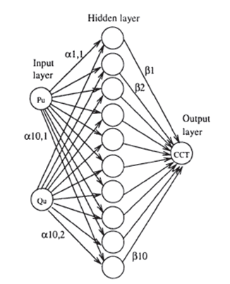
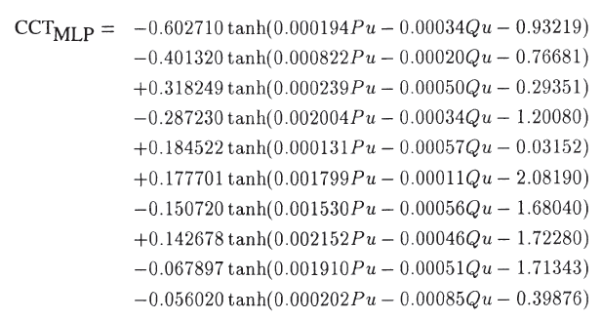
ANN structure and tuned weights
After tuning the weights
Source: Automatic Learning techniques in Power Systems, L. Wehenkel

Slide 23
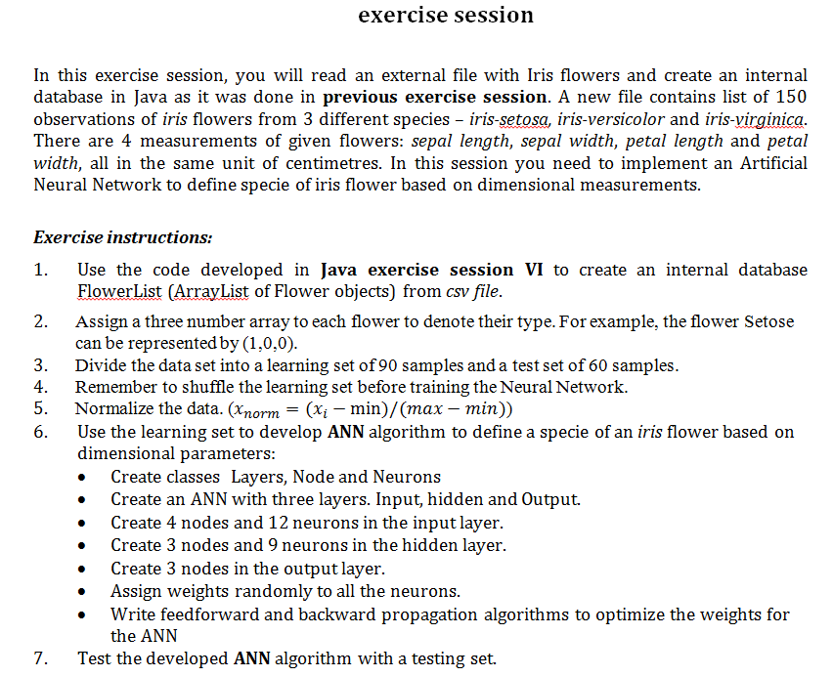
Assignment

Slide 24
Questions?
Lars Nordström
larsno@kth.se
Kaveh Paridari
paridari@kth.se

